Slide 1



Evaluation in the Generative AI Era
How to build more trustworthy evaluation metrics and evaluation platform to drive AI progress?
Presenter: Wenhu Chen
Assistant Professor at David R. Cheriton School of Computer Science

Slide 2
Outline
Introduction
Motivation
TIGERScore
VIEScore
GEnAI Arena
Takeaway

Slide 3







Generative AI Era

Slide 4

Why is Evaluation Important?
Development -> Evaluation -> Refinement -> …
Benchmarking the progress
Scientific Rigorous Claims
Explainability

Slide 5
Why is Evaluation Hard?
Text Generation
Not restricted to specific tasks, more broad instruction following capability
The fluency and surface form looks great. The underlying consistency and factuality are hard
Image Generation
FID/IS are mostly model-based evaluation metrics
Per-instance evaluation metrics (CLIP/DINO-score, DreamScore, LPIPS) are unreliable.
Video Generation
FVD/x-clipscore are totally unreliable
Wild west, heavily relying on human evaluation

Slide 6
Building Better Evaluation Metrics
TIGERScore: one metric to evaluate all text generation tasks
Explainable
Reference-free
Aspect-driven
VIEScore: one metric to evaluate all conditional image generation tasks
Zero-shot
Explainability
Task-aware

Slide 7
Building Better Human Evaluation Platform
ImagenHub
Standardized evaluation protocol
Standardized prompts/hyper-parameters
Encompass seven image generation tasks
GenAI Arena
Model-vs-Model Battlefield
Community-driven voting
Elo ranking

Slide 8
TIGERScore: Towards Building Explainable Metric for all text generation tasks
Dongfu Jiang, Yishan Li, Ge Zhang, Wenhao Huang, Bill Yuchen Lin, Wenhu Chen

Slide 9
Introduction: Current Issues
Dependency on references:
ROUGE, BLEU, COMET, InstructScore
Limited to specific domains:
COMET for translation
BLEURT for translation, data2text
Lack of Attributions:
BARTScore, BERTScore, GPTScore, etc, only outputs a unreadable number as score

Slide 10

Introduction: Universal Metric
What is a good universal metric?
Reference-free
Multiple tasks
Explainability
eval results
overall rating
natural language explanations
eval results
Metric
eval results
Metric
input
output
reference
Metric
summarization
translation
input
output
reference
data2text
long-form QA
input
output
reference
instruction-following
math
$$⋯⋯$$
Multiple tasks
Notes:
- reference-free: reference-based is good for simply benchmarking a whole model. But reference-free is essential in real-world evaluation, where reference is hard to find.
- Multiple tasks: We don’t want to change the metric every time we change a task. Instead, one single metric for all task is the reason that it is universal.
- Explainability: a single number is not trustworthy enough. The ultimate goal is that the universal metric can be really applied to evaluate real-world examples, where explanations are essential for users to trust the eval results.

Slide 11
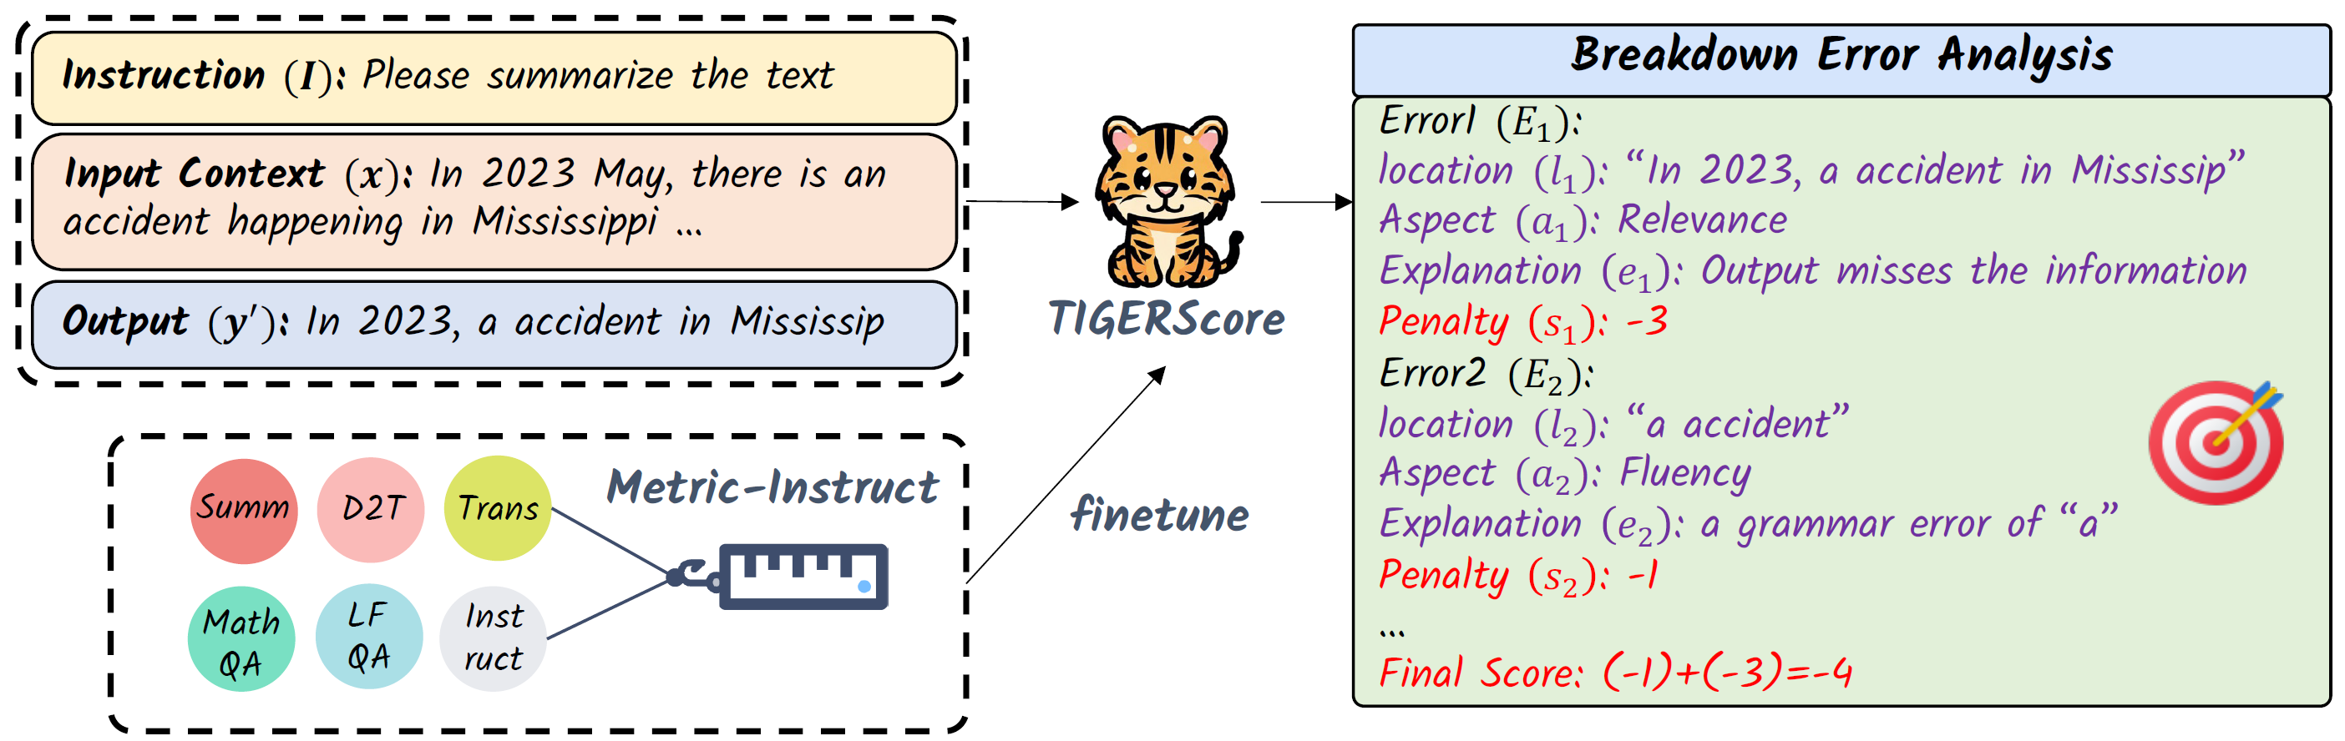
TIGERScore
Design Principles:
Reference-Free
Driven by Instructions (Multiple Tasks)
Self-explainable
Multi-aspect Evaluation
Penalty-scoring System
Structured Analysis Output

Slide 12
TIGERScore: Reference-Free
No reference required

Slide 13
TIGERScore: Driven by Instructions
Each instruction represents different task

Slide 14
TIGERScore: Self-Explainable
Error analysis and explanations

Slide 15
TIGERScore: Multi-aspect Evaluation
Error analysis and explanations

Slide 16

TIGERScore: Penalty-Scoring Systems
Penalty score for each error ranges from $\left[−5,−0.5\right]$
The final overall score is the sum of all the penalties

Slide 17
TIGERScore: Structured Analysis Output
Each error consists of: Location, Aspect, Explanation, Penalty Score
The overall analysis output is: multiple identified errors + final score

Slide 18
MetricInstruct: Curation Pipeline
What does the training data come from?
Systems
Pre-defined aspects
Sampling
Inputs
Outputs
Prompt Template
Query
GPT-4
Collect and Filter
Error Analysis
Fine-tune
TIGERScore

Slide 19
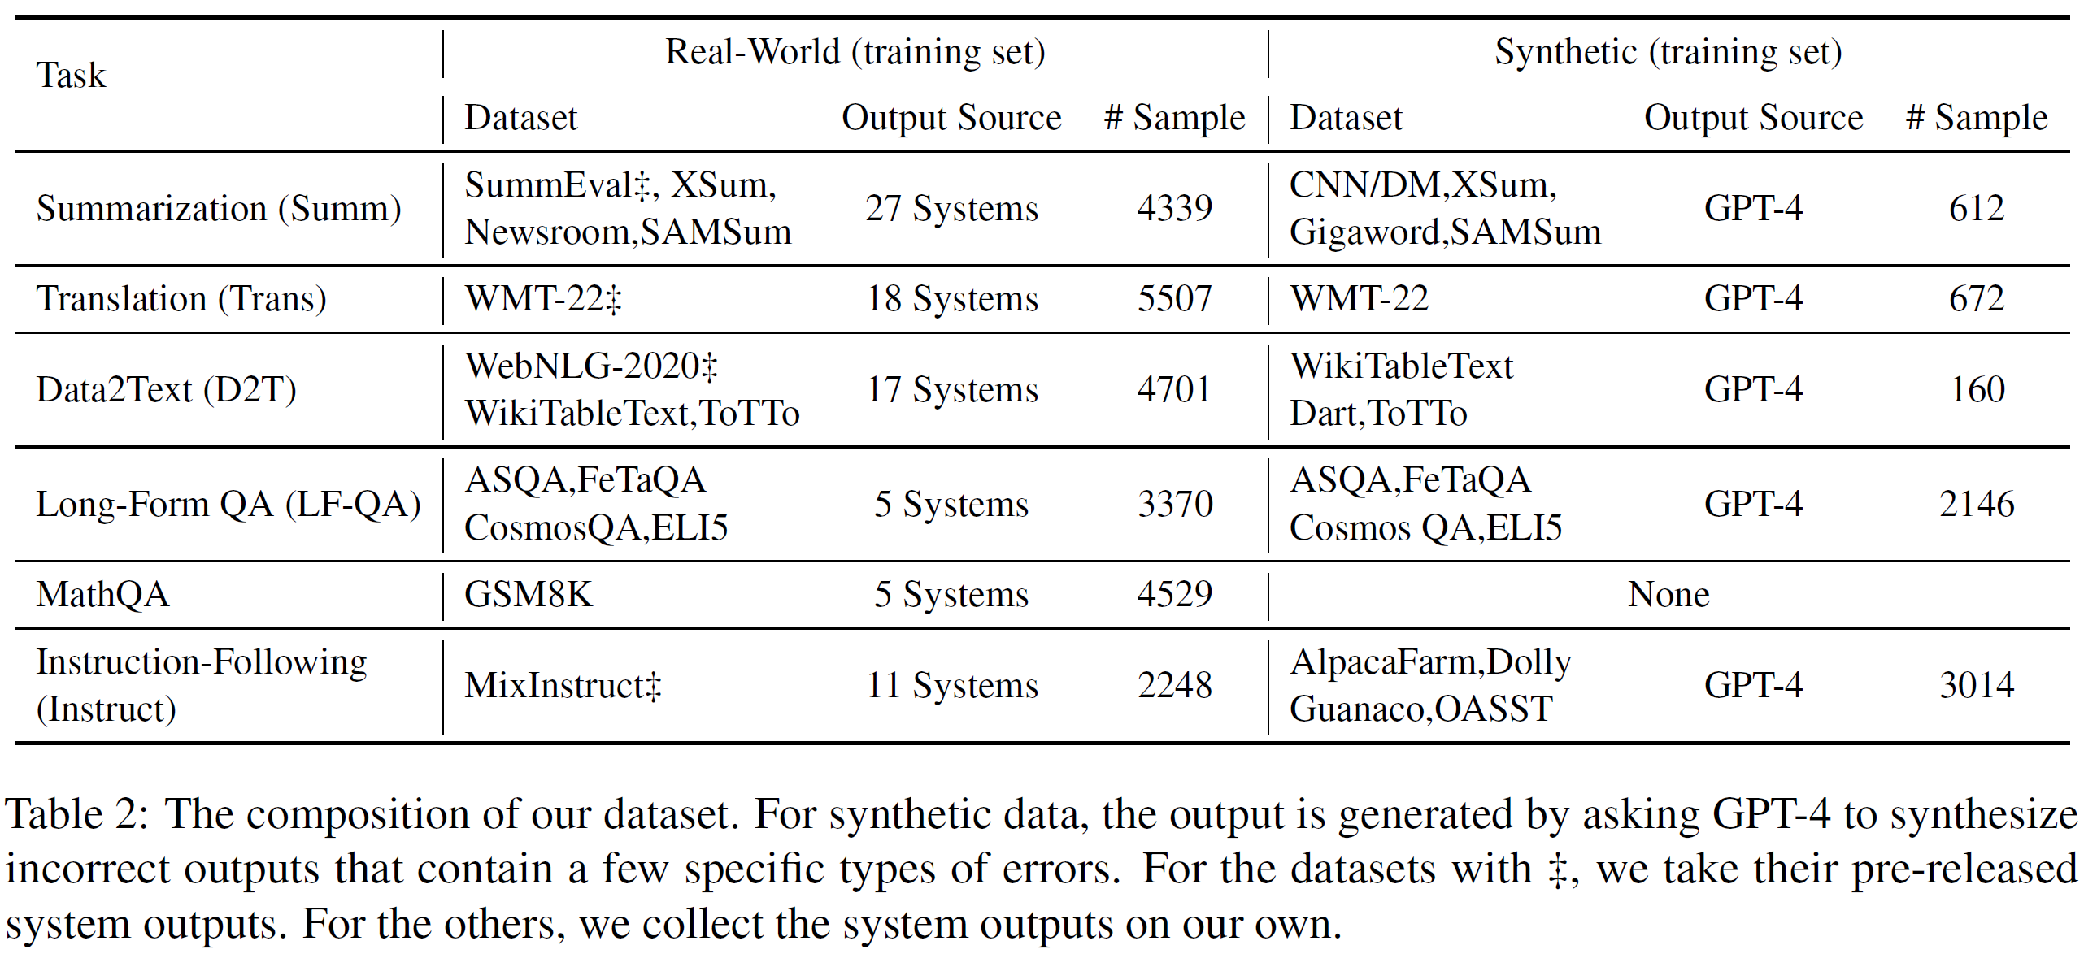
MetricInstruct: Properties
Dataset diversity: 23 distinct dataset across 6 general NLG tasks
Error Coverage: more than 50+ systems’ outputs are collected.

Slide 20
MetricInstruct: Properties
Quality Ensurance: various heuristics used to filter the bad-quality data.
Error location mismatch
Illogical severity labels
Excessively long outputs
Bad explanation that like “based on the reference, it should be … instead of …”.

Slide 21
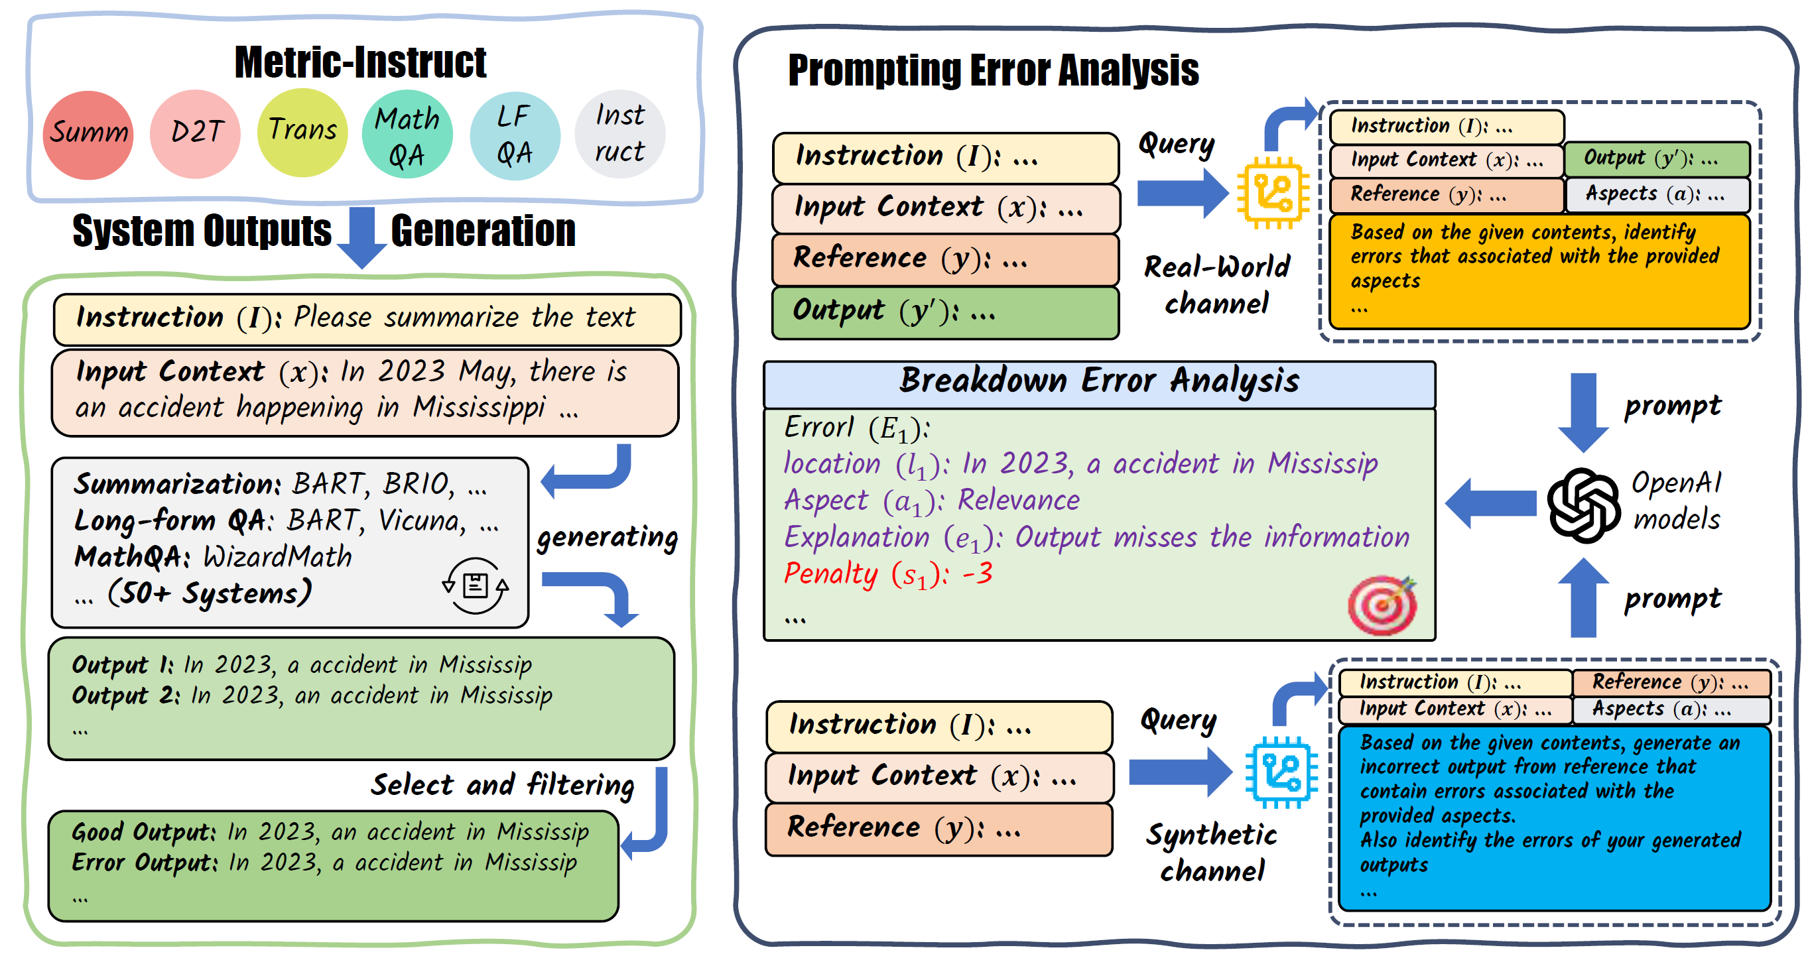
MetricInstruct: Properties
Two channel curation:
Real-world channel:
system outputs generated from 50+ models
Synthetic channels:
system outputs synthesized by GPT-4
To ensure the system outputs contain more diverse error types.
Total 32k after filtering

Slide 22
Experiments: Training settings
Backbone: Llama-2-7b and Llama-2-13b
Context length: 1024; Batch size: 128;
7B:
4 80G A100 GPUs, 3 epochs, learning rate 2e-5.
13B:
8 80G A100 GPUs, 2 epochs, learning rate 1e-5.
Inference:
Using VLLM for acceleration during the testing

Slide 23
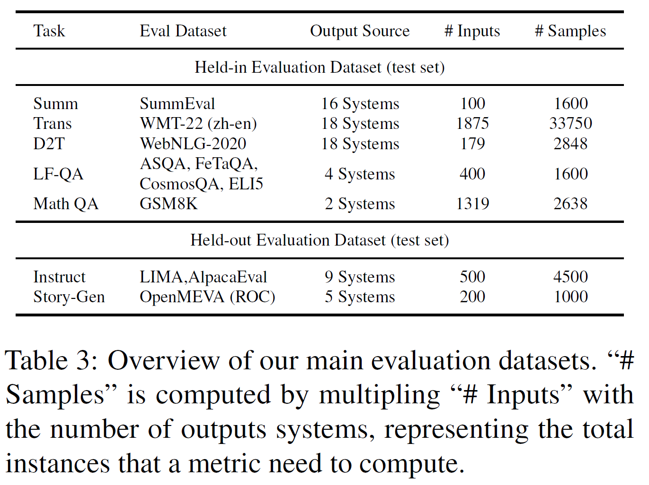
Experiments: Testing datasets
5 held-in and 2 held-out
Correlation metrics:
Pearson
Spearman
Kendall
Human ratings comes from:
Official human rating of that dataset
GPT-4 scores

Slide 24
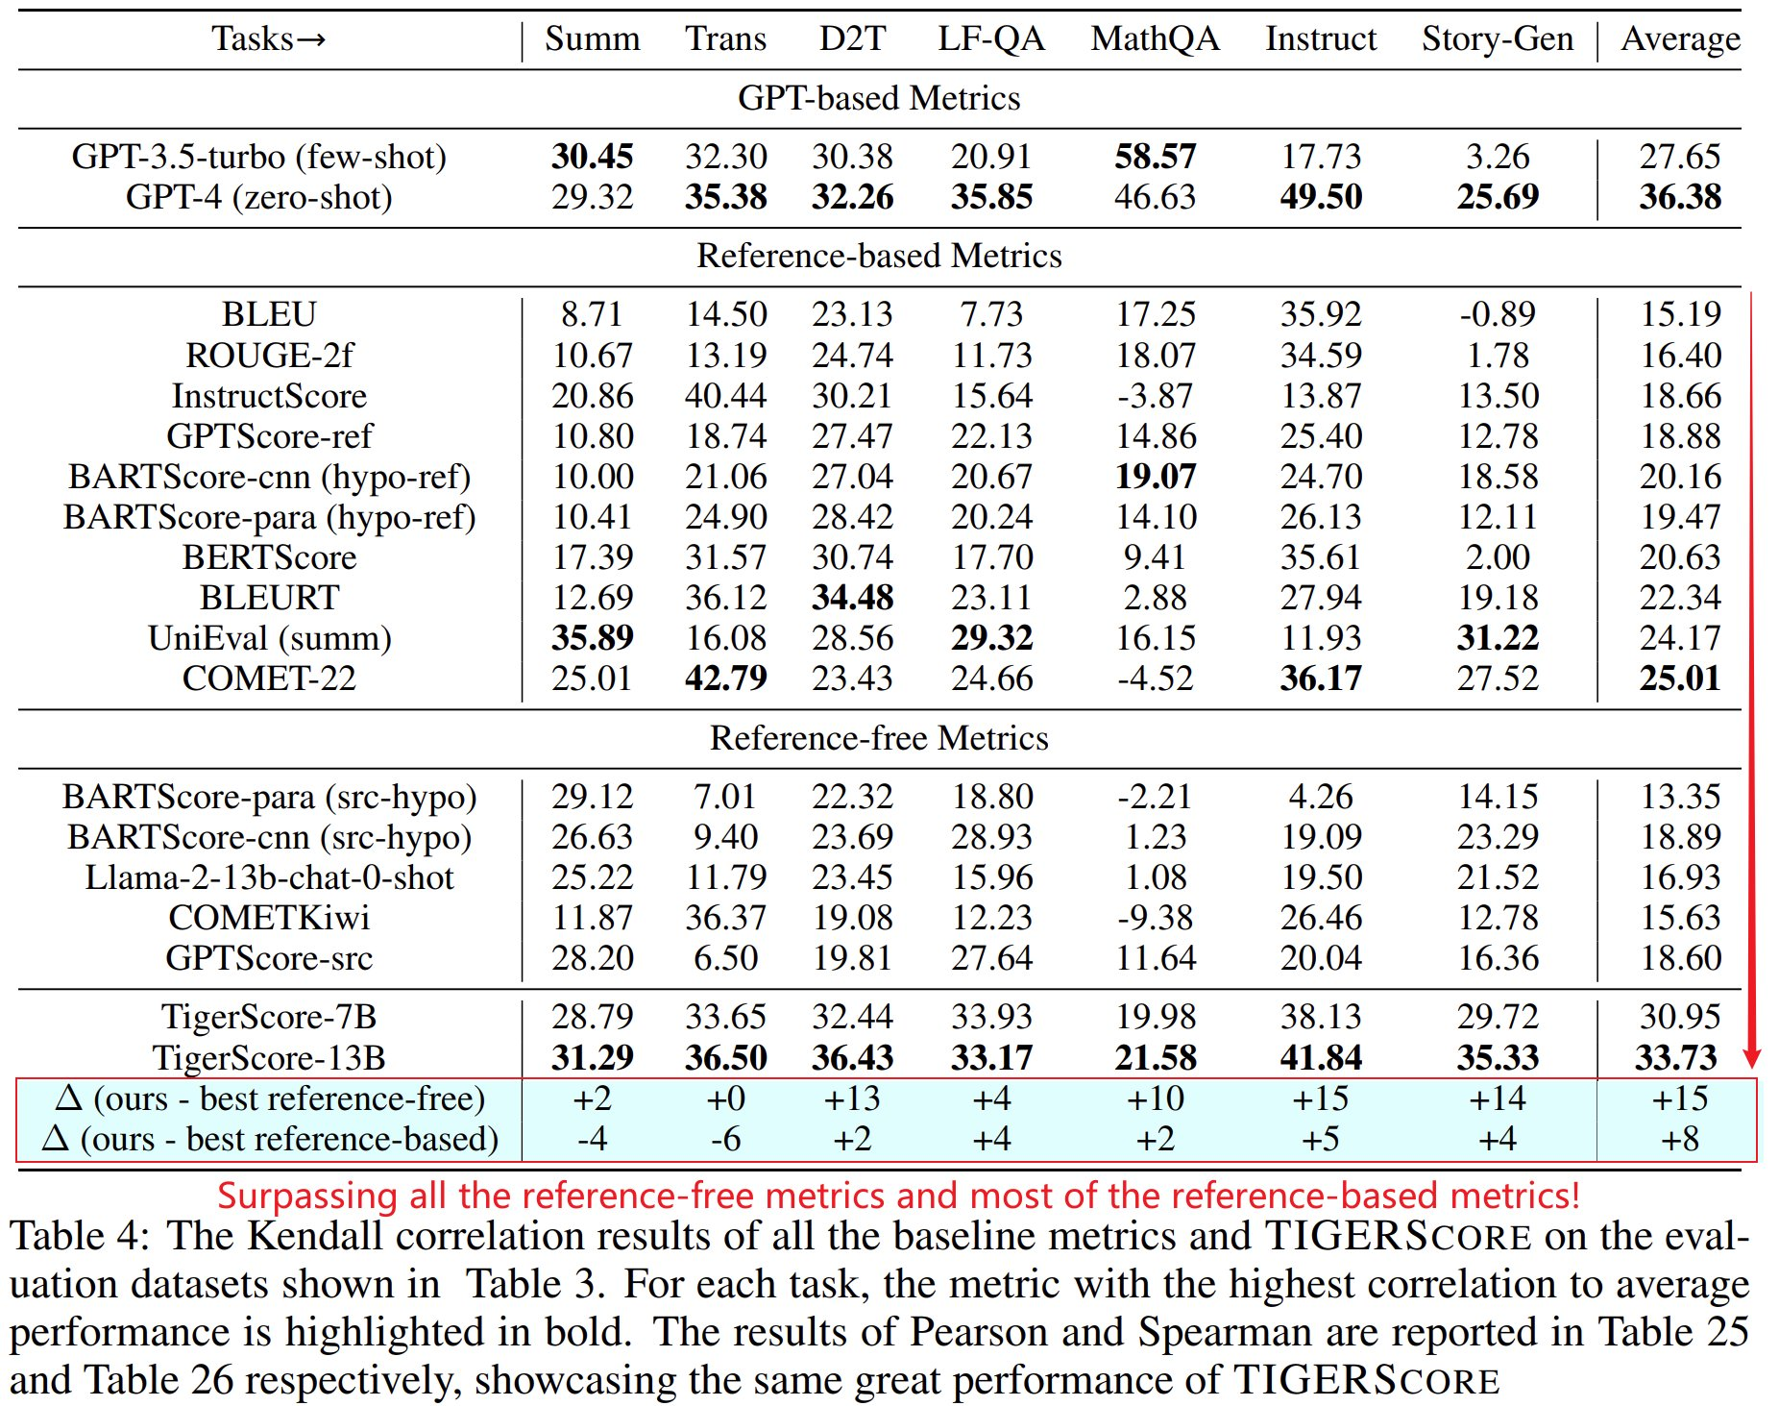
Experiments: Correlation Results
Overall best cross both all other metrics
Best of all tasks compared with other reference-free metrics
Best for 5 tasks out of 7 compared with reference-based metrics
Approaching performance compared with GPT-4 zero-shot

Slide 25
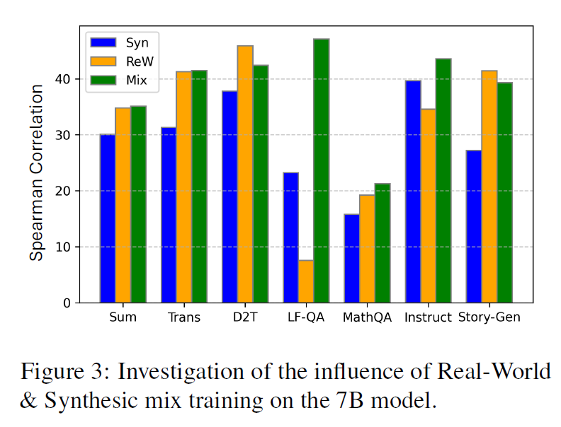
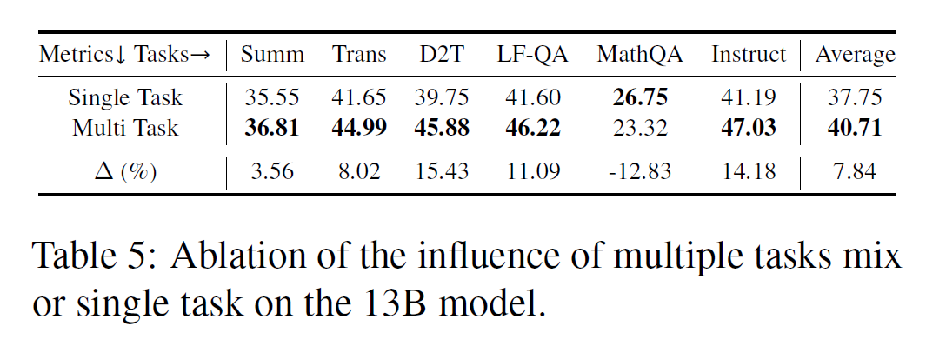
Experiments: Ablation Study
Whether multi-task learning benefit?
Whether 2 channel mixing works?

Slide 26
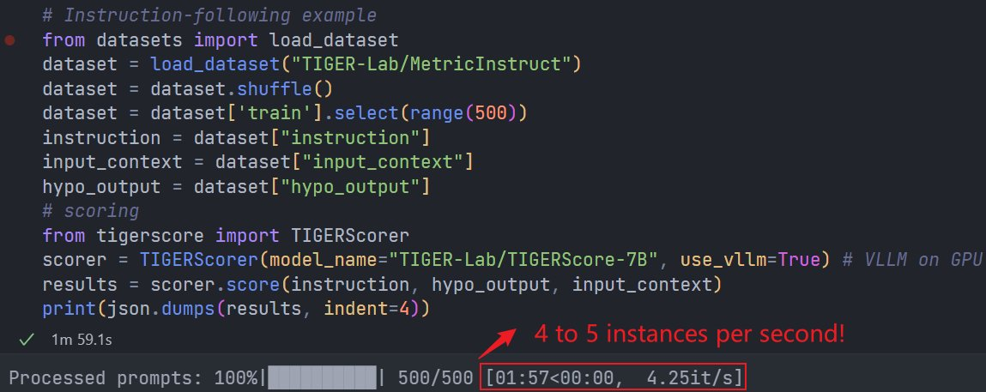
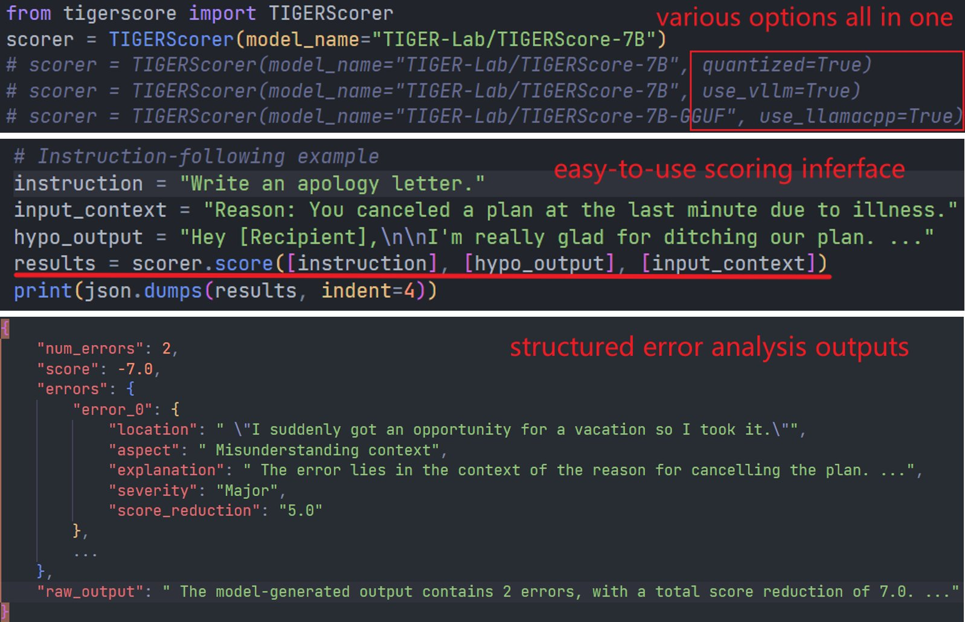

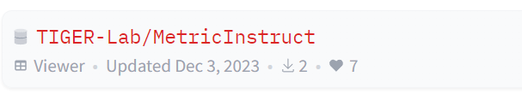
Community Using

Slide 27
Takeaway
We build the first all-in-one LLM-based evaluation metrics
Approaching GPT-4 level correlation on most tasks
Highly explainable error analysis
Run on CPU with 4 toks/sec
Things to improve
The metric could still hallucinate in the error analysis
The metrics have worse performance on MathQA/Reasoning tasks

Slide 28
ImagenHub: Standardizing the evaluation of conditional image generation models
Max Ku, Tianle Li, Kai Zhang, Yujie Lu, Xingyu Fu, Wenwen Zhuang, Wenhu Chen
ICLR 2024

Slide 29
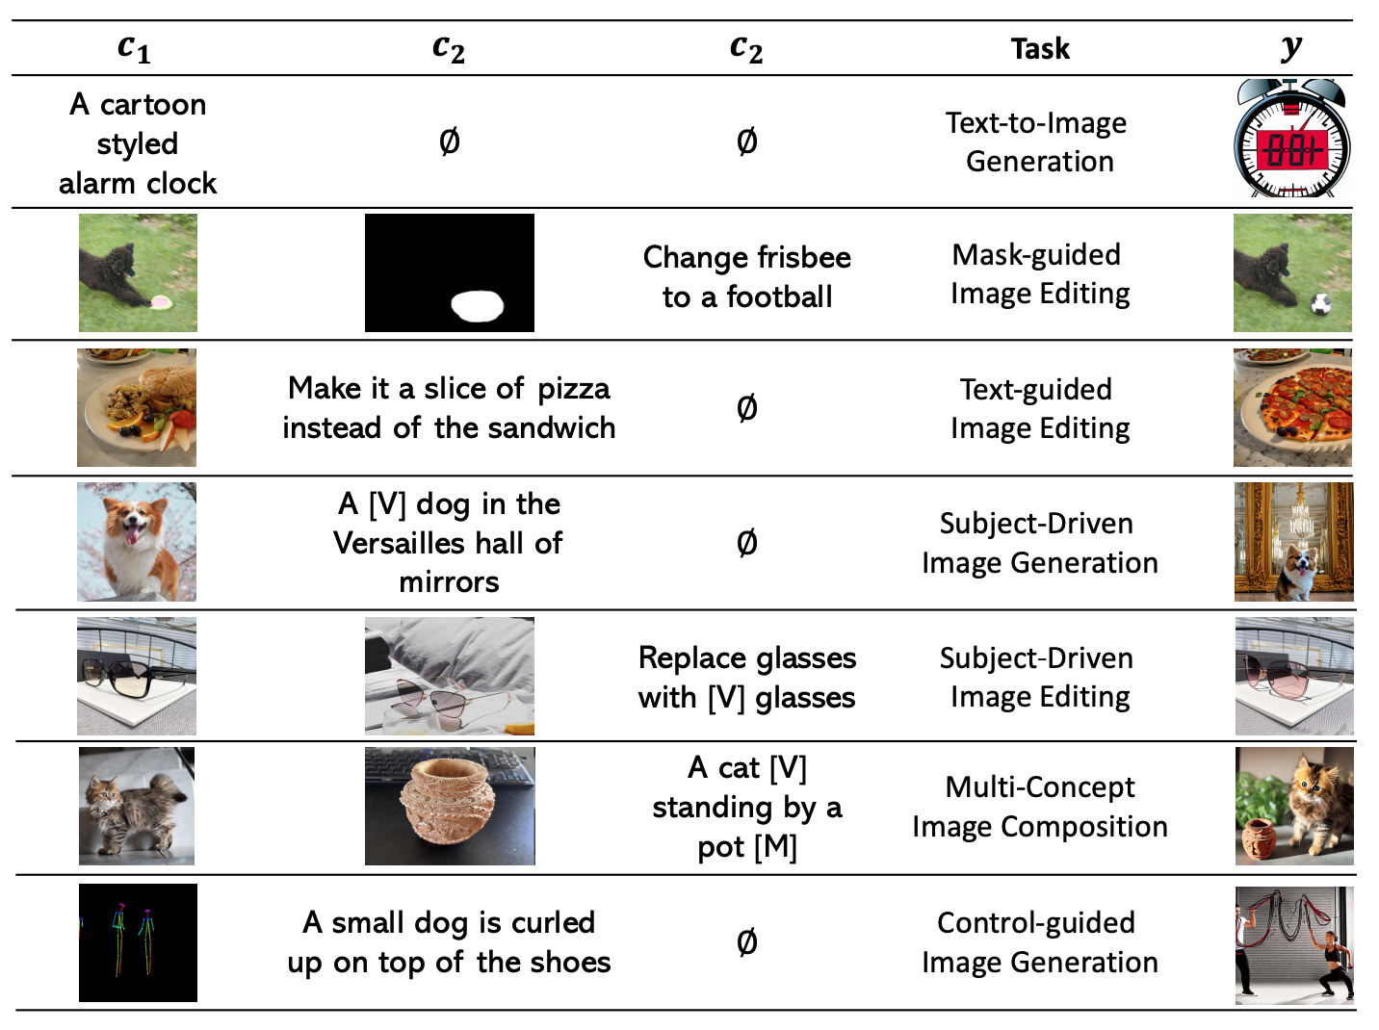
Conditional Image Generation

Slide 30
Background
Each paper performs their own evaluation
CLIP/DINO scores are not reliable
Different prompt
Different sampling strategy
Different hyper-parameters
No paper reports inter-human agreement
Some papers only employ 1 person/instance for judgement
Low correlation and high variance

Slide 31
Standardizing the Evaluation
Standardizing the input data
Standardizing the inference function
Standardizing human evaluation protocol

Slide 32
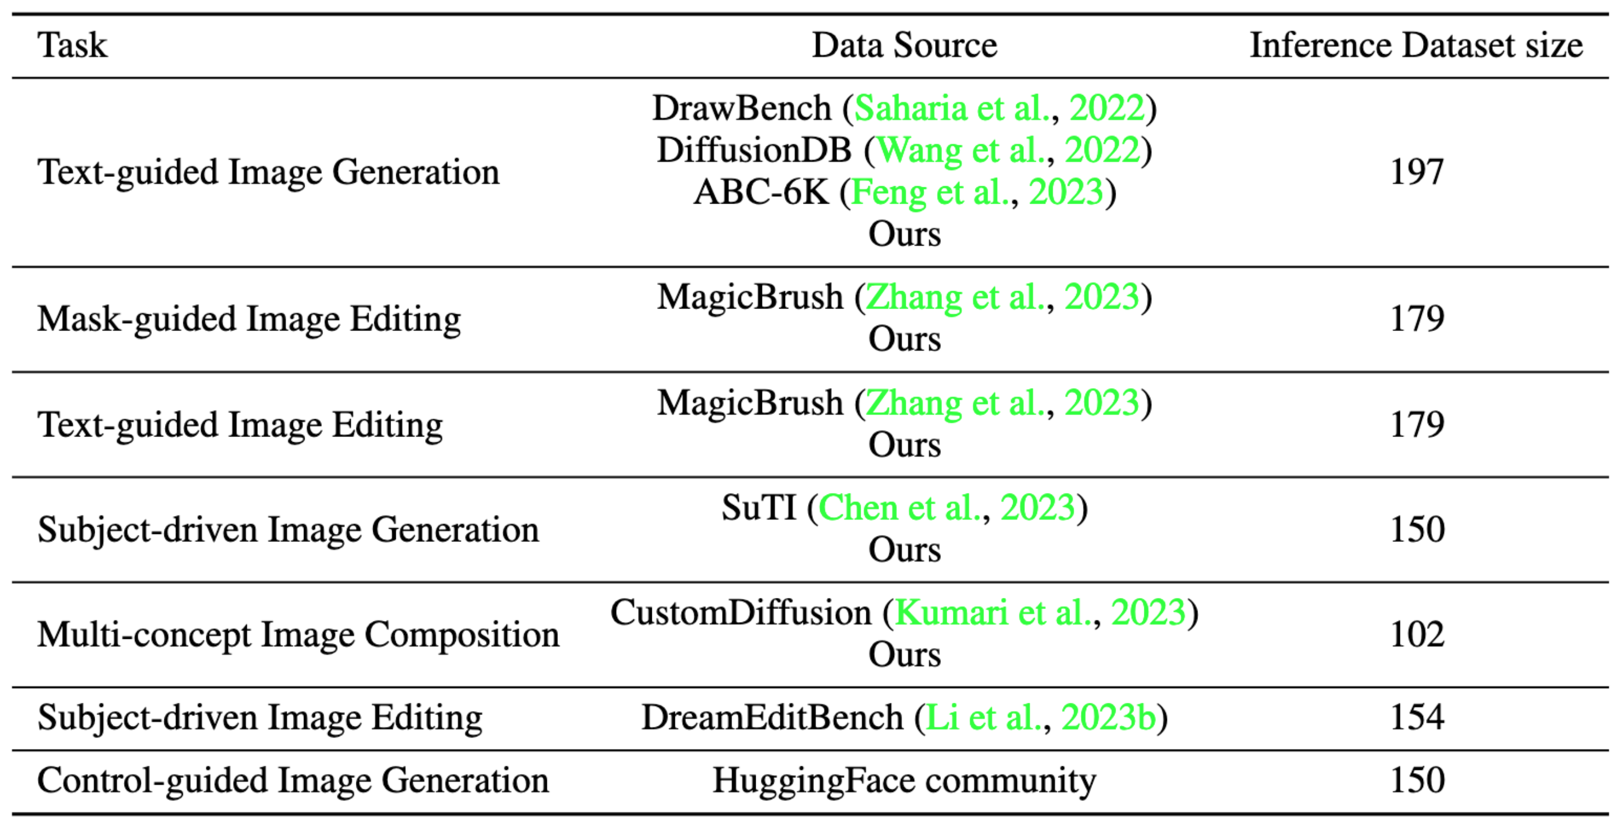
ImagenHub Dataset

Slide 33
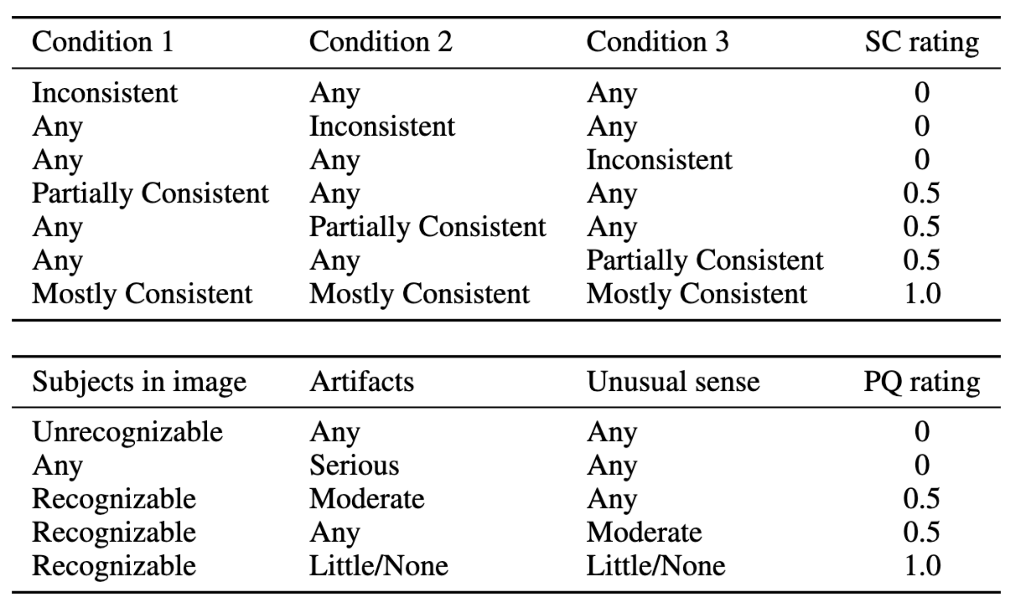
Human Evaluation Protocol
Semantic
Perceptual

Slide 34
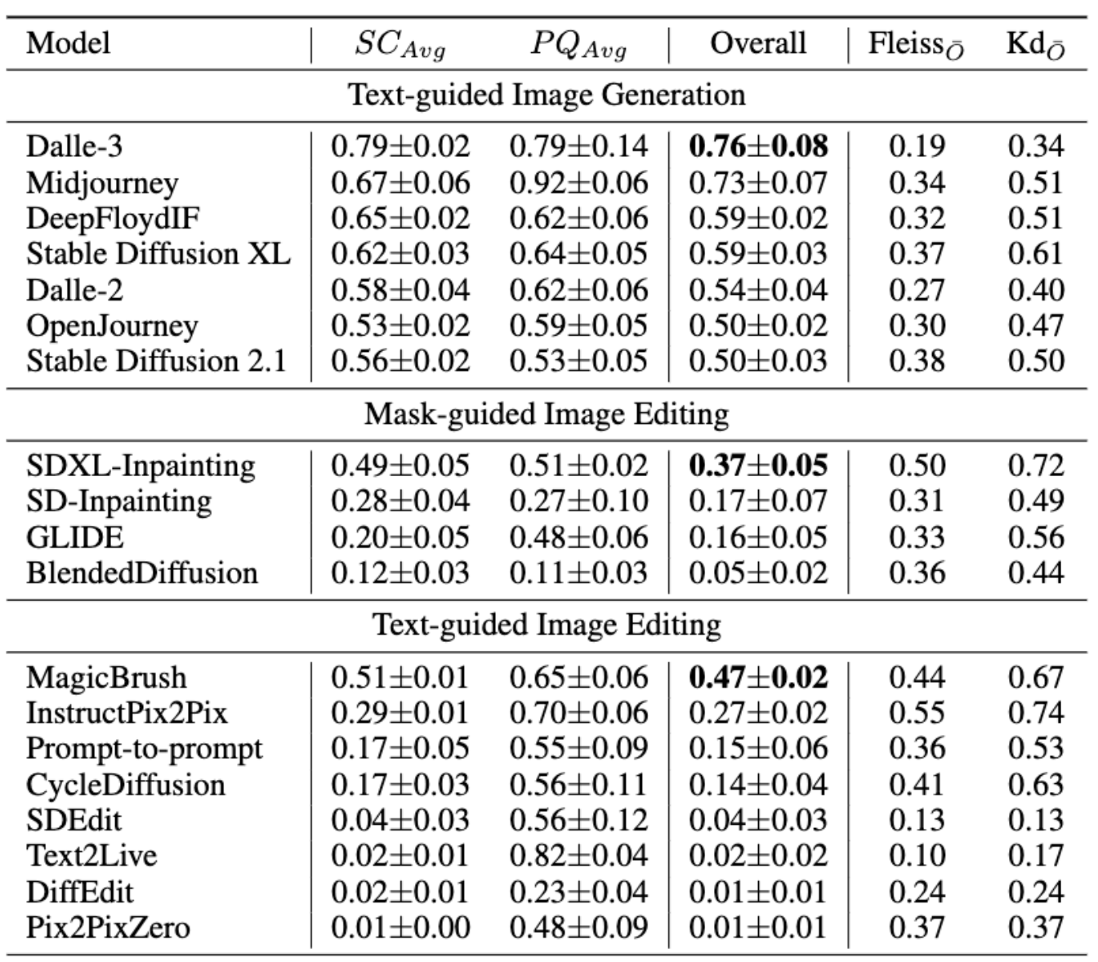

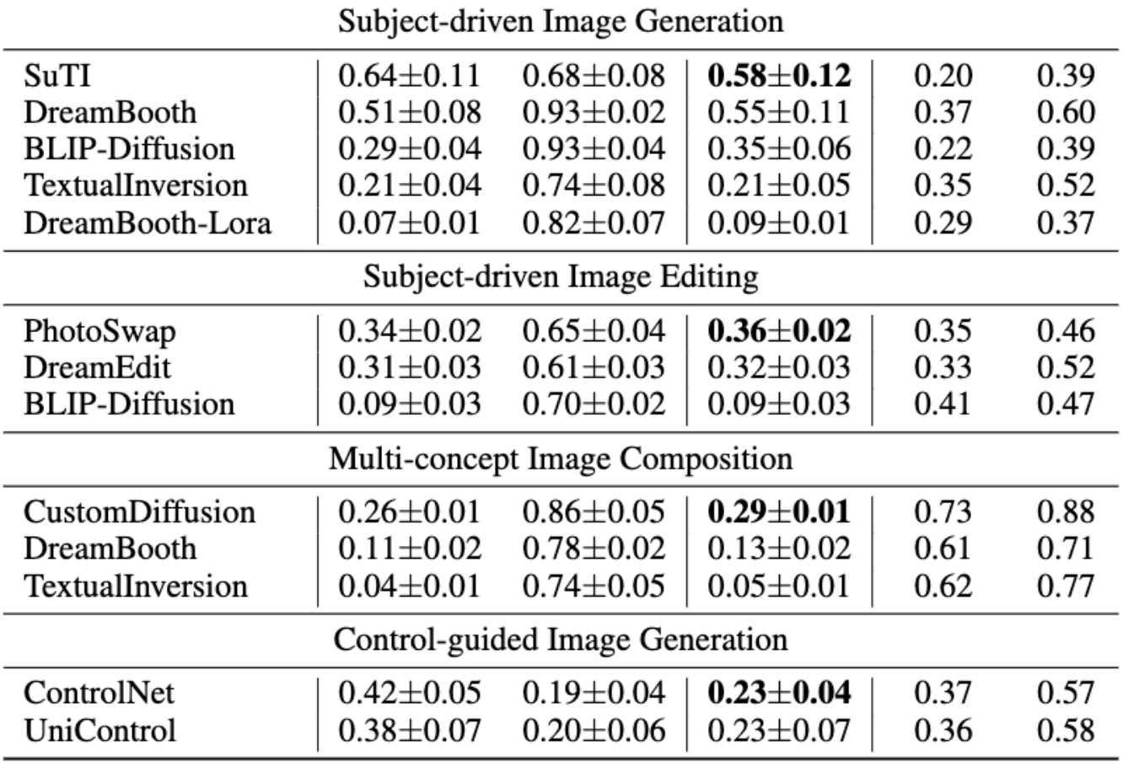
Human Evaluation Ranking

Slide 35
Takeaway
Existing models’ performance is generally unsatisfying except for Text-guided Image Generation and Subject-driven Image Generation, with 74% models achieving an overall score lower than 0.5.
We examined the claims from published papers and found 83% of them hold with a few exceptions.
None of the existing automatic metrics has a Spearman’s correlation higher than 0.2 except subject-driven image generation.

Slide 36
VIEScore: Towards Explainable Metrics for Conditional Image Synthesis Evaluation
Max Ku, Dongfu Jiang, Cong Wei, Xiang Yue, Wenhu Chen

Slide 37
Human Evaluation & Model Evaluation
ImagenHub requires human experts to evaluate the outputs
Expensive
Inefficient
Subjective
Can we replace human evaluator with model-based evaluator?
LPIPS
DINO
CLIP
DreamSim
FID/KID

Slide 38
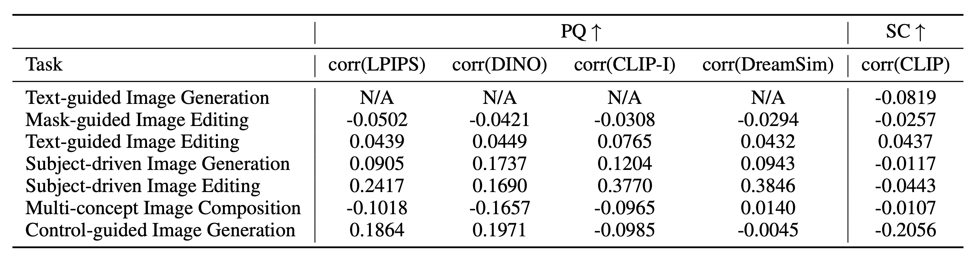
How well are Automatic Metrics?
Pearson’s correlation between model-based metrics vs human evaluation
The correlation is generally very low, most of them are lower than 0.2!

Slide 39
How about Multimodal Language Models?
Prompting multimodal language models to give explanation and then output a score.

Slide 40
Multimodal Language Model Evaluation
Multimodal Conditions

Slide 41
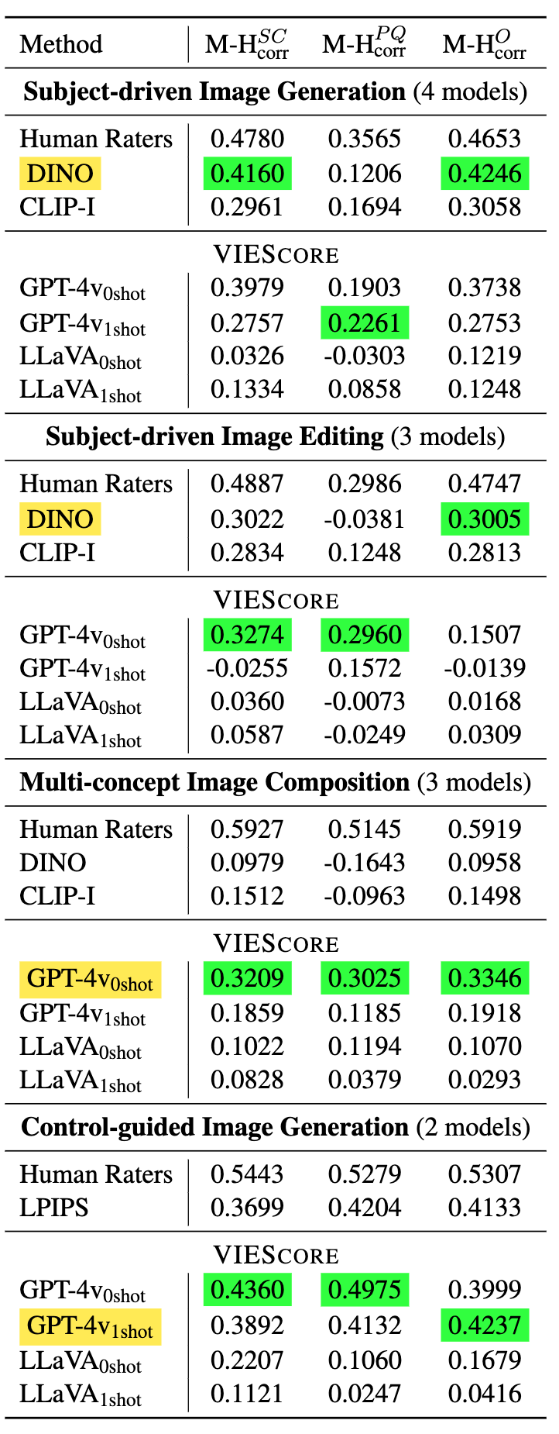
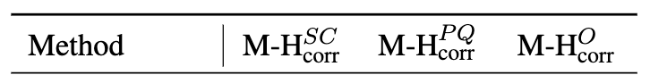
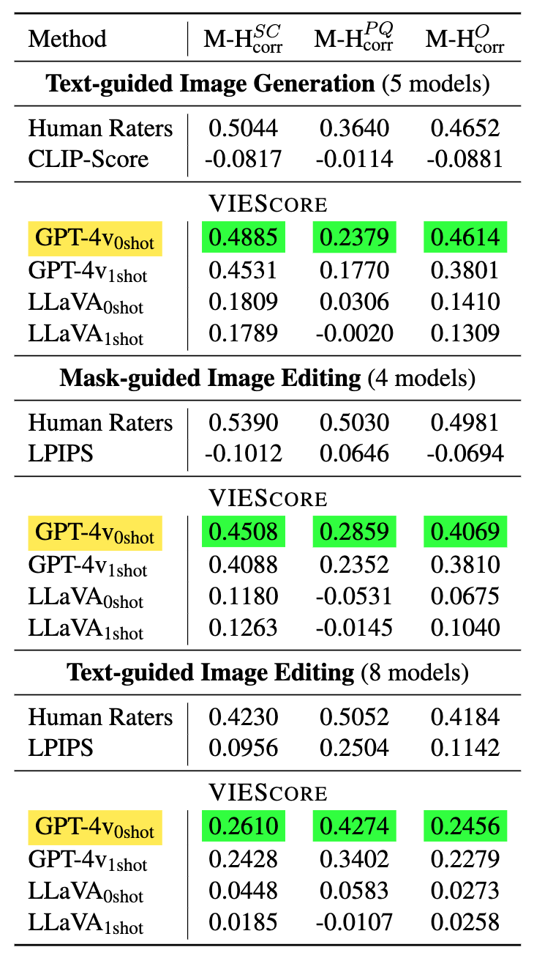
VIEScore Correlation with Humans

Slide 42
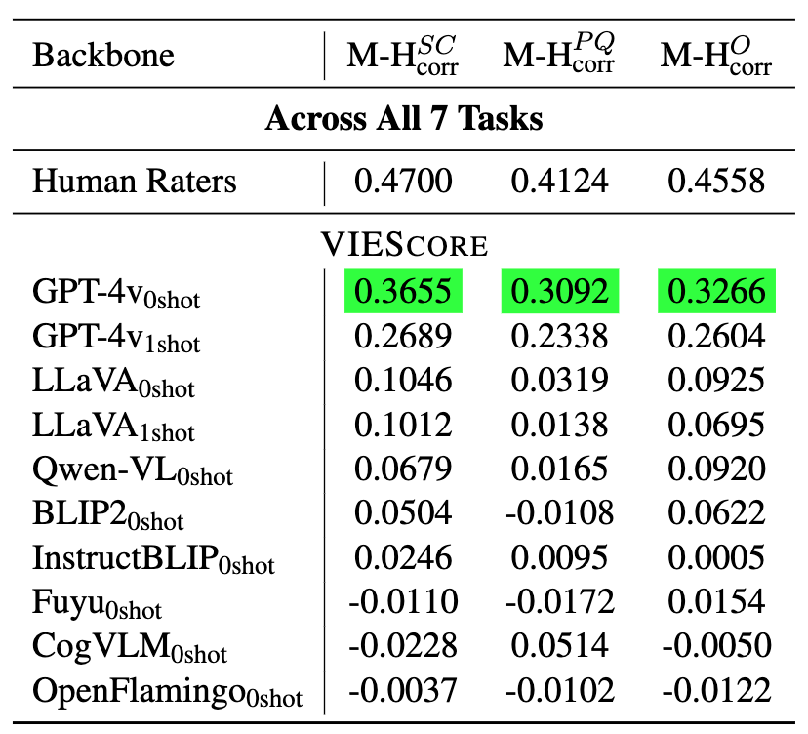
Takeaway
GPT4-v achieves a relatively high Spearman Correlation
The general correlation is around 0.3
Human-to-Human correlation is around 0.45.
GPT-4v has high variance, we need to take average of five runs to obtain a more stable score
Editing tasks with nuances is still hard for GPT-4v to evaluate

Slide 43
GenAI-Arena: Community-based evaluation platform for visual generation
Max Ku, Tianle Li, Kai Zhang, Yujie Lu, Xingyu Fu, Wenwen Zhuang, Wenhu Chen

Slide 44
Motivation
Lmsys adopts community-voting arena for LLM ranking
It receives wide range of attention
The lmsys leaderboard is becoming one of the most widely-used metric
Hard to evaluate; very robust and fair.

Slide 45
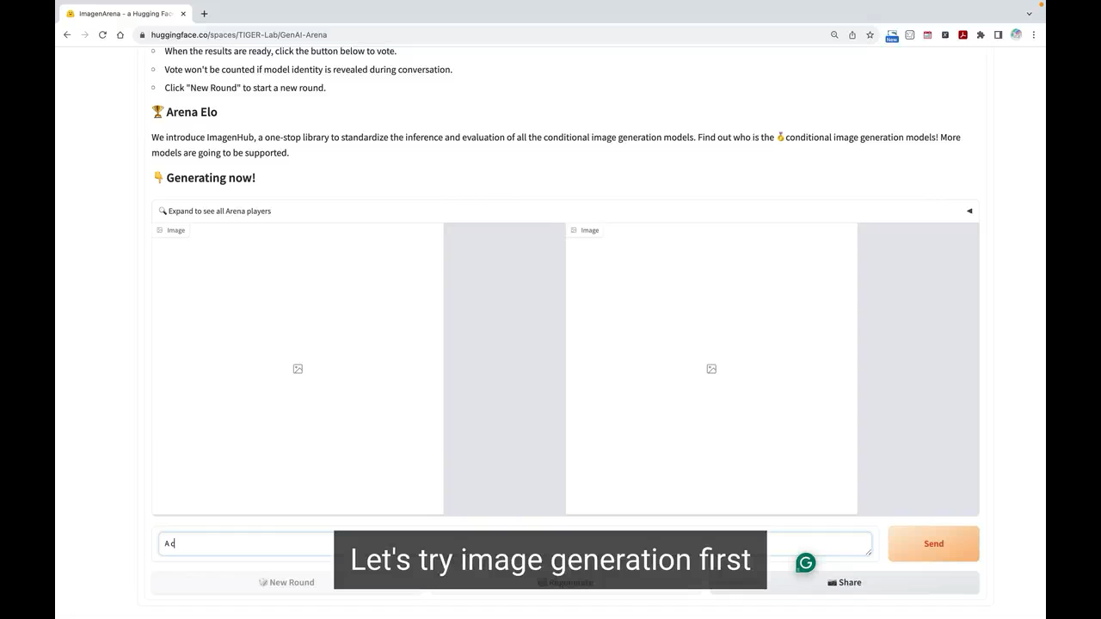
GenAI Arena

Slide 46
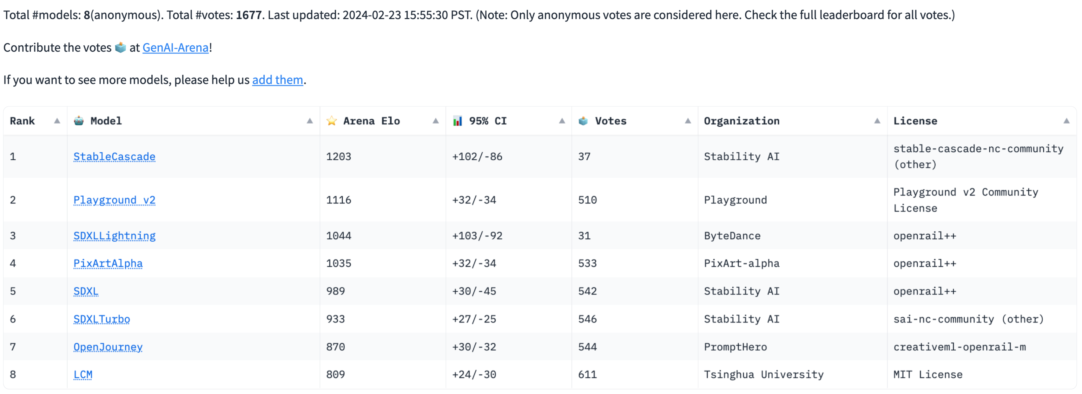
Generation Leaderboard

Slide 47
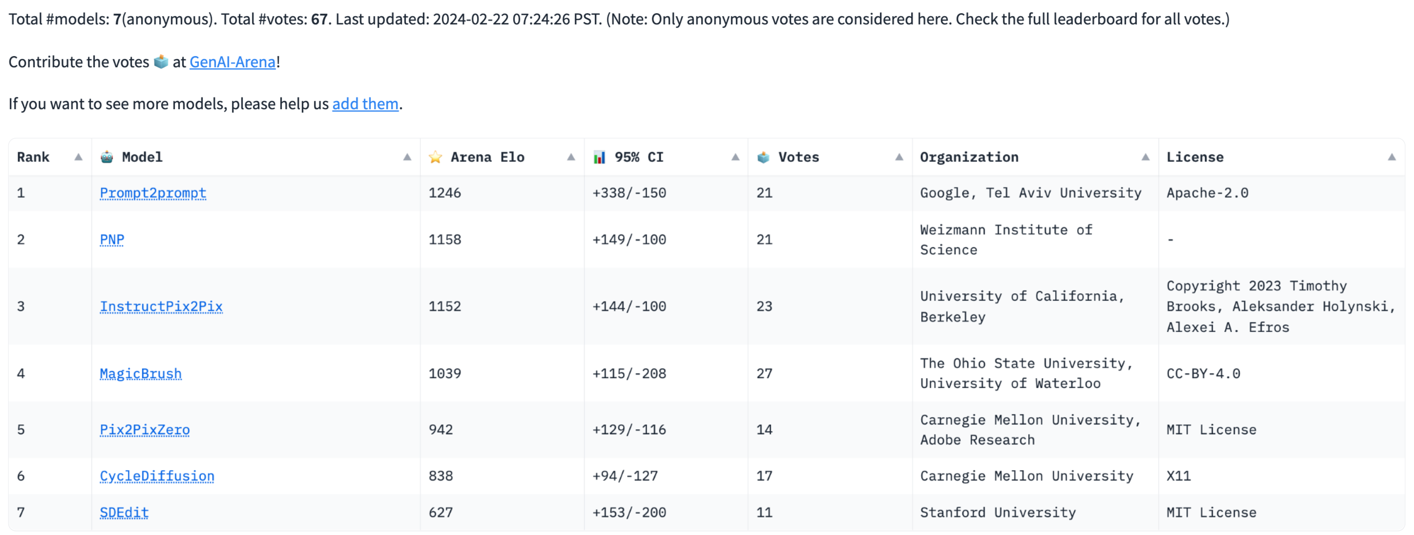
Editing Leaderboard

Slide 48
Future Work
The evaluation in the visual generation is still overlooked.
The existing metrics are still focused on text-to-image generation.
Other controllable generation is being overlooked.
Video generation evaluation is also wild west.
We need more people to work and explore in this field.

Slide 49
References
TIGERScore: Towards Building Explainable Metric for All Text Generation Tasks
Dongfu Jiang*, Yishan Li*, Ge Zhang, Wenhao Huang, Bill Yuchen Lin, Wenhu Chen
VIEScore: Towards Explainable Metrics for Conditional Image Synthesis Evaluation
Max Ku, Dongfu Jiang, Cong Wei, Xiang Yue, Wenhu Chen
ImagenHub: Standardizing the evaluation of conditional image generation models
Max Ku, Tianle Li, Kai Zhang, Yujie Lu, Xingyu Fu, Wenwen Zhuang, Wenhu Chen
GPTScore: Evaluate as You Desire
Jinlan Fu, See-Kiong Ng, Zhengbao Jiang, Pengfei Liu
INSTRUCTSCORE: Explainable Text Generation Evaluation with Finegrained Feedback
Wenda Xu, Danqing Wang, Liangming Pan, Zhenqiao Song, Markus Freitag, William Yang Wang, Lei Li
Perils of Self-Feedback: Self-Bias Amplifies in Large Language Models
Wenda Xu, Guanglei Zhu, Xuandong Zhao, Liangming Pan, Lei Li, William Yang Wang

Slide 50
Thanks! Questions?

